Slide 1
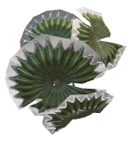
Sri M. S. Team name: The sons of Demeter
Swaminathan Agri-robot

Slide 2

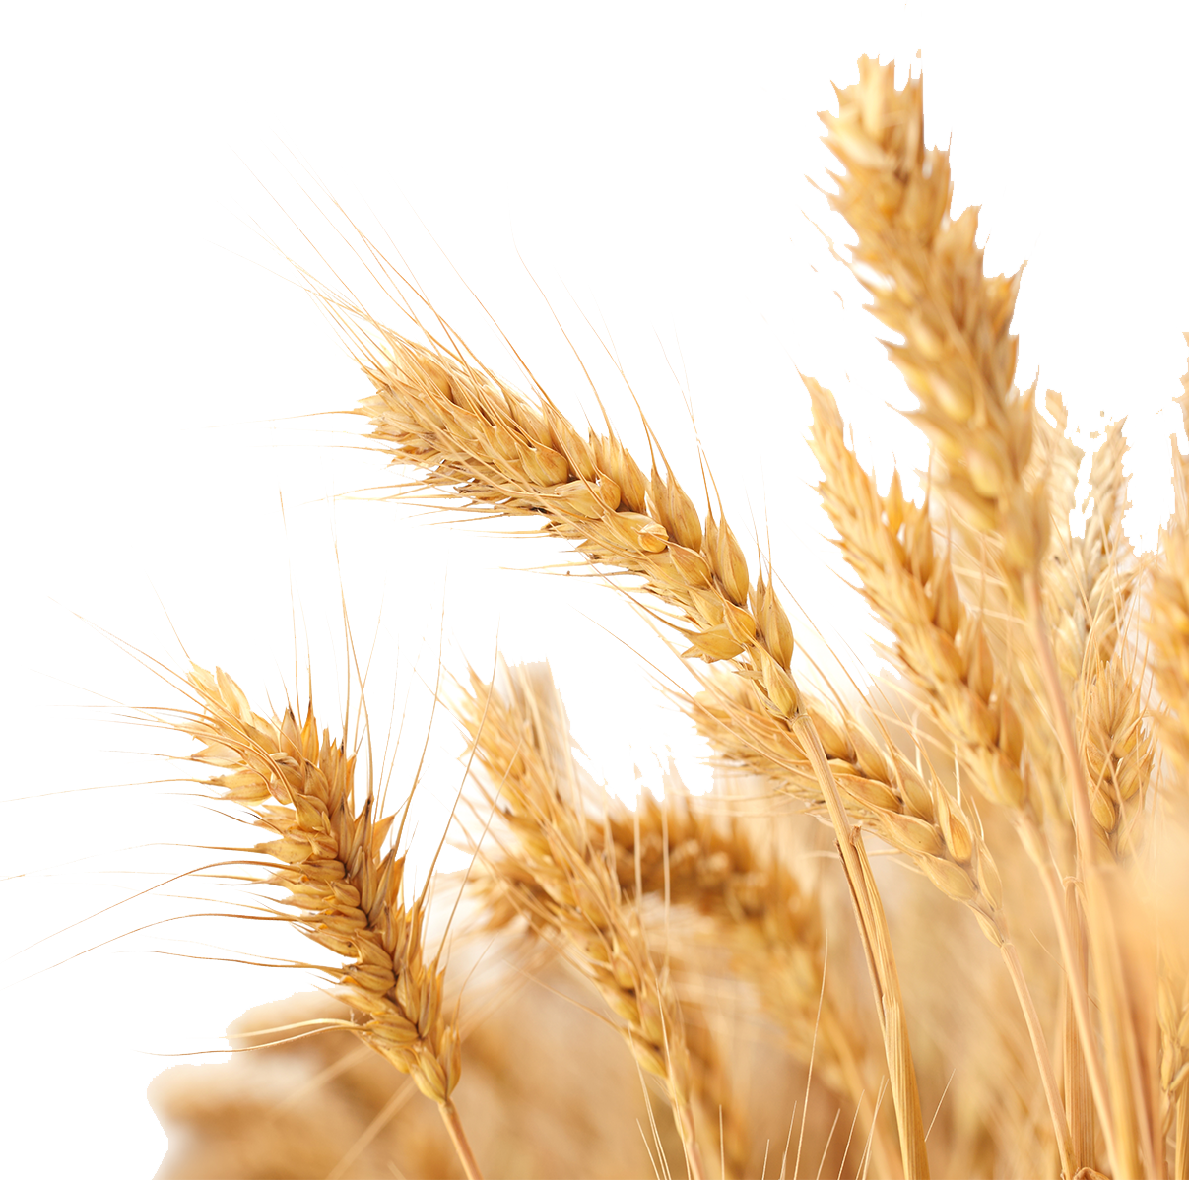
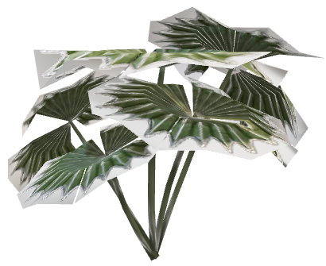
Sri M. S. Swaminathan Agri-bot
Team name: The sons of Demeter

Slide 3
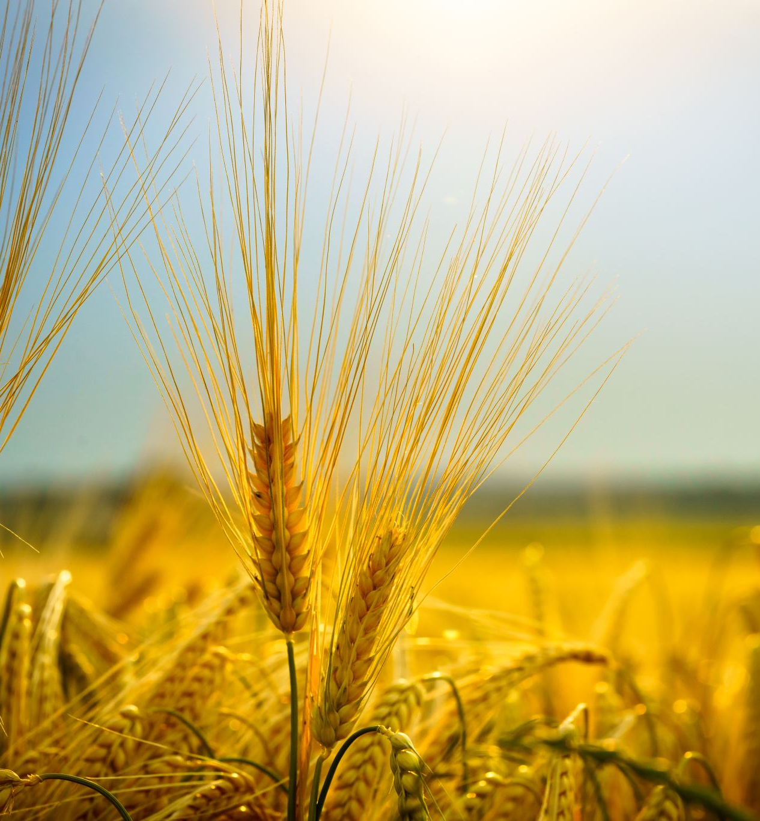

Problem Statement
Traditional Agricultural methods are plagued by a plethora of problems, such as:
Labour Shortages: Urban migration causes a shortage of available labour for cultivation.
Low Productivity: Manual methods lead to lower yield per square unit of land area.
Inefficient Resource Use: Traditional farming practices may not optimize the use of resources like water, fertilizers, and pesticides, leading to waste and environmental impact.
Increased Costs: Lack of sensors can result in over- or under-application of inputs like water, fertilizers, and pesticides, leading to increased costs and environmental damage.

Slide 4
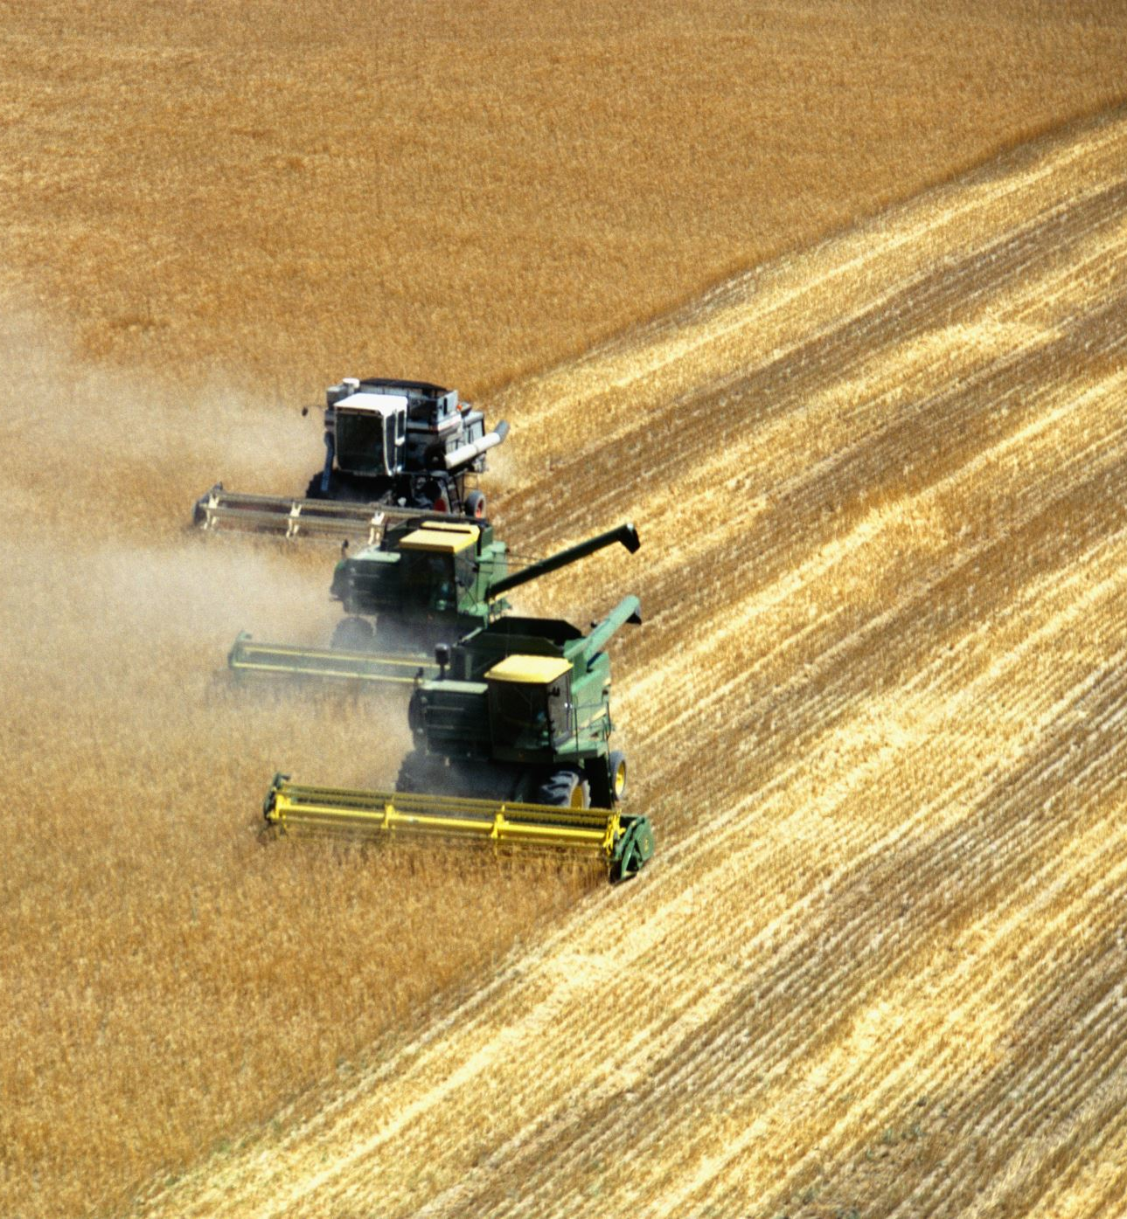

The Solution
Our robot provides the ultimate solution to these problems:
Increased Efficiency: Sensors and automation can streamline agricultural processes, reducing labor costs and increasing productivity.
Enhanced Crop Quality: Automation can improve the precision of tasks like planting, irrigation, and harvesting, leading to higher-quality crops.
Improved Decision Making: Sensors provide data-driven insights that can help farmers make informed decisions about crop management.
Remote Monitoring: Automation enables remote monitoring of agricultural operations, allowing farmers to manage their farms from anywhere.

Slide 5




Overview
The robot is equipped with several mechanisms that automate critical tasks, reducing manual labour required for farming.
Mechanisms include – Seed Sower, water dispenser, pesticide dispenser, soil tiller arm, soil ridging system, and more.
The robot is all terrain, meaning even if there are rocks in the path of the robot, it can overcome them with ease.
Includes a camera that can be remotely accessed via mobile phone.

Slide 6





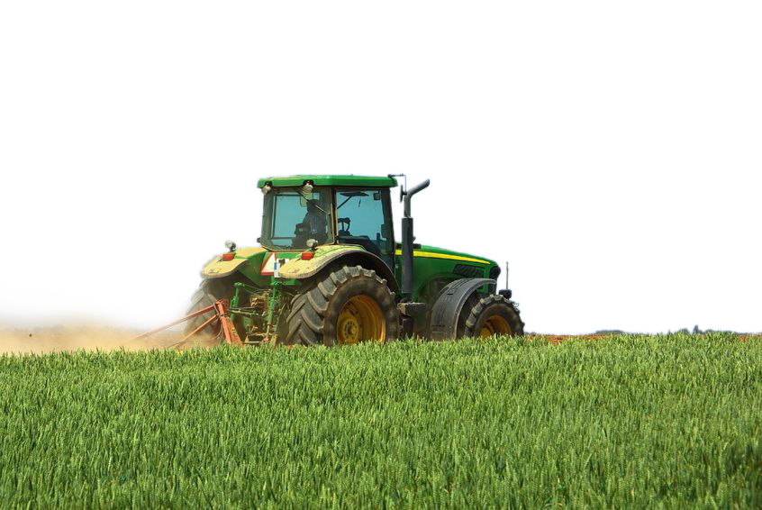
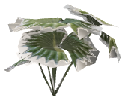
The robot makes an initial pass of the area to be cultivated with the Tilling arm and/or the Ridging arm lowered, tilling or ridging the soil as required.
In the next pass, the arm is retracted, and the seeding, watering and pesticide mechanisms are activated. All of this is done remotely.

Slide 7

Soil Tilling
Tilling the soil is necessary, as it breaks up soil clumps which aerates the soil, promoting root growth and preventing soil erosion.
A soil tiller attachment is mounted on the rear of the robot, which effectively tills the soil behind it.
This attachment can be lifted and lowered remotely by a 12-volt motor.

Slide 8
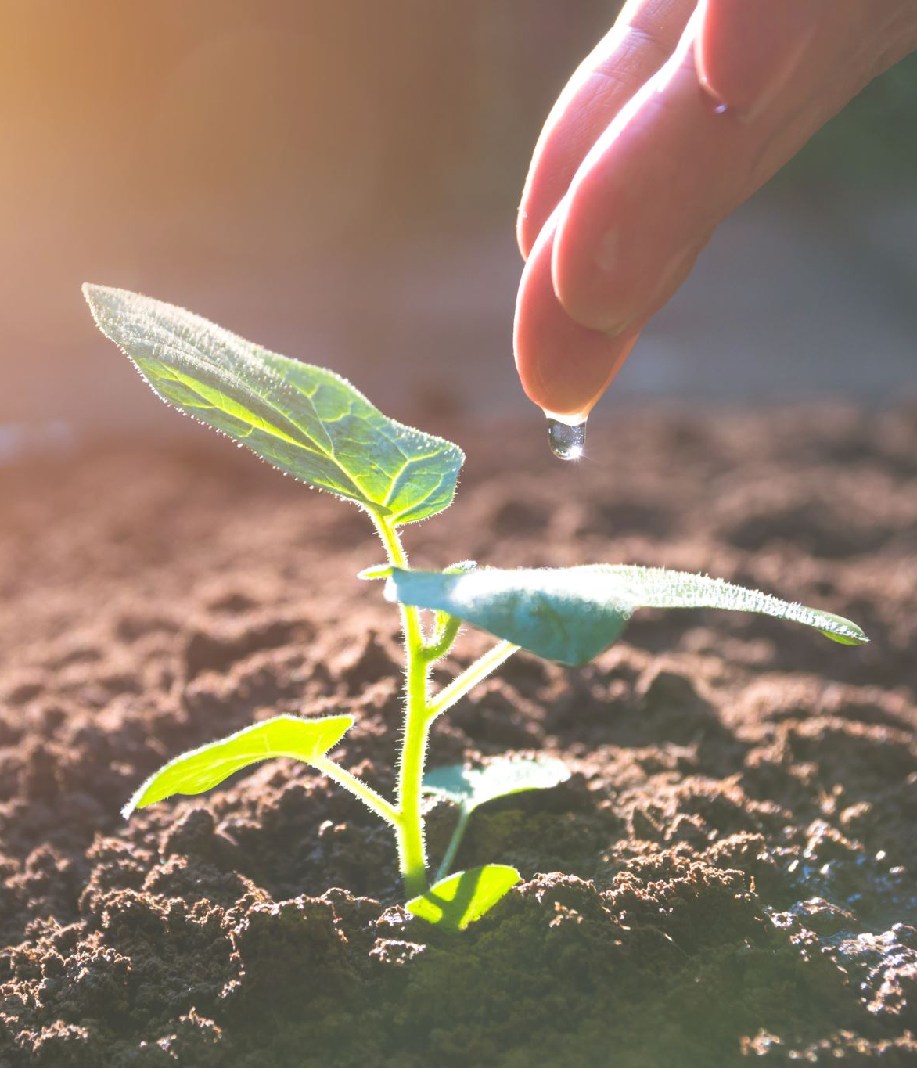
Soil Ridging
Soil ridging is crucial, especially in areas prone to waterlogging, as it ensures good drainage and enhanced nutrient retention.
A separate, custom-made arrangement is attached behind the robot, responsible for soil ridging.
The first pass of the robot ends here. The robot then makes a second pass of the farmland, with the tilling arm retracted.

Slide 9
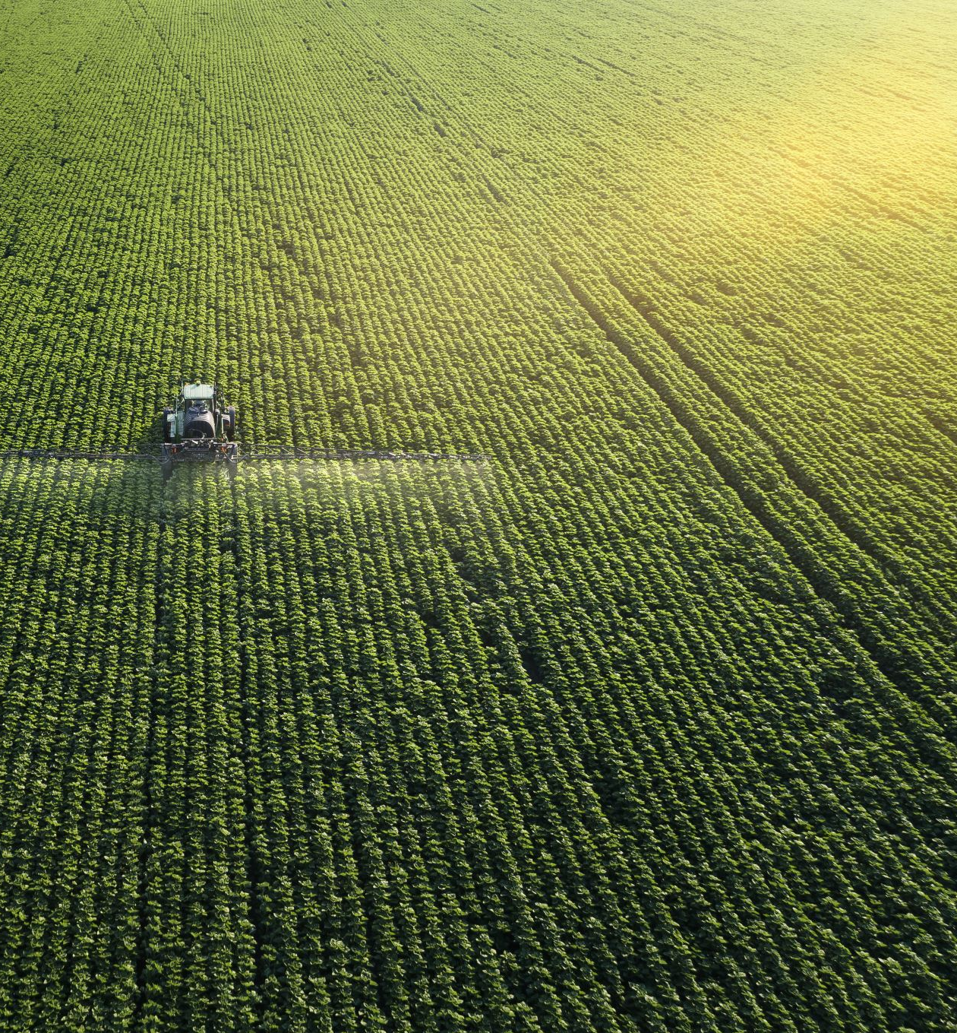


Seed Planter
Arguably the most important part of the overall process, the seeds for the crops need to be planted evenly, and with precision.
This is achieved via a seed dispenser system driven by a 12-volt motor, controlled remotely via Bluetooth using Arduino Uno and HC-05 BT Module.

Slide 10



Water & Pesticide Dispenser
Water is the most essential thing needed for crop growth, and pesticides ensure the crops do not get infected by unwanted insects or other bugs.
Water and Pesticide are stored on the robot itself, which is sprayed after the seed is planted.
A pump is the heart of this system, which is controlled remotely via Bluetooth using Arduino Uno and HC-05 BT module.

Slide 11



Sensor Suite
To ensure optimal performance and control, the robot is equipped with a suite of sensors that monitor its environment and operations.
These sensors collect data in real-time and transmit it to a cloud-based platform for analysis.
Based on the data, the robot's functions can be adjusted and controlled remotely.
Sensors are connected to an ESP32 module which is acting as a Wi-Fi client, and thus can transmit data wirelessly to cloud.

Slide 12
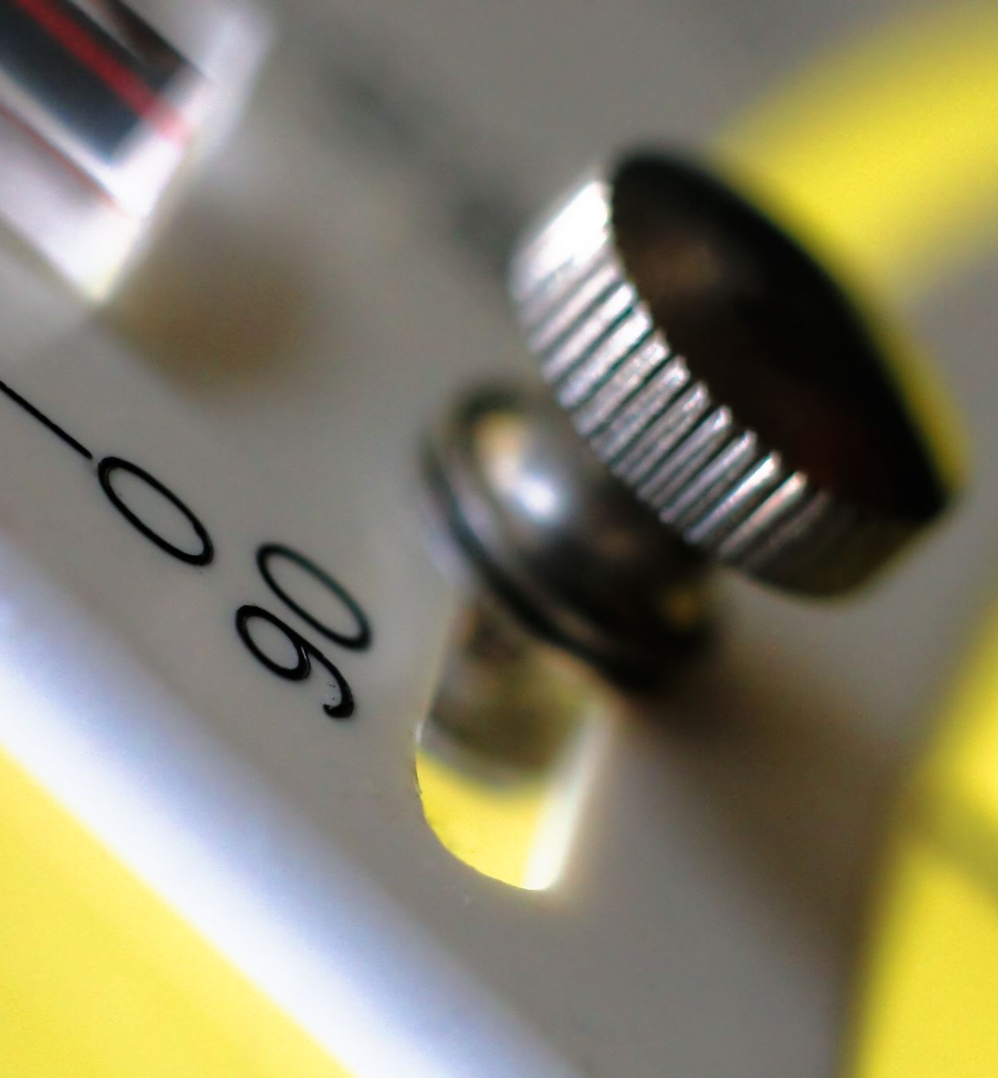
DHT11 Sensor – Humidity and Temperature
The DHT11 is a low-cost, easy to use sensor.
It uses a thermistor for measuring temperature, and a capacitive humidity sensor.
Temperature and Humidity are essential parameters to measure, as they directly correlate to how much water the crops require, and how frequently.

Slide 13

GPS Sensor
To ensure precise control and navigation, the remotely operated robot utilizes a Global Positioning System (GPS).
The GPS module, a GY-NEO6MV2, provides positional accuracy of 2.5 meters, allowing for accurate tracking and route adjustments.

Slide 14

Soil Moisture Sensor
A soil moisture sensor is also important to determine if the soil needs watering.
This sensor in particular is attached to a mechanism controlled by Bluetooth via Arduino Uno and HC-05 BT Module.
This mechanism can insert and retract the soil sensor into the ground upon wireless user input.

Slide 15


Gas Sensor
Air quality monitoring is done by the Gas Sensor.
An MQ135 sensor module is used, which can detect various gases such as ammonia, benzene, smoke, carbon dioxide, etc..

Slide 16
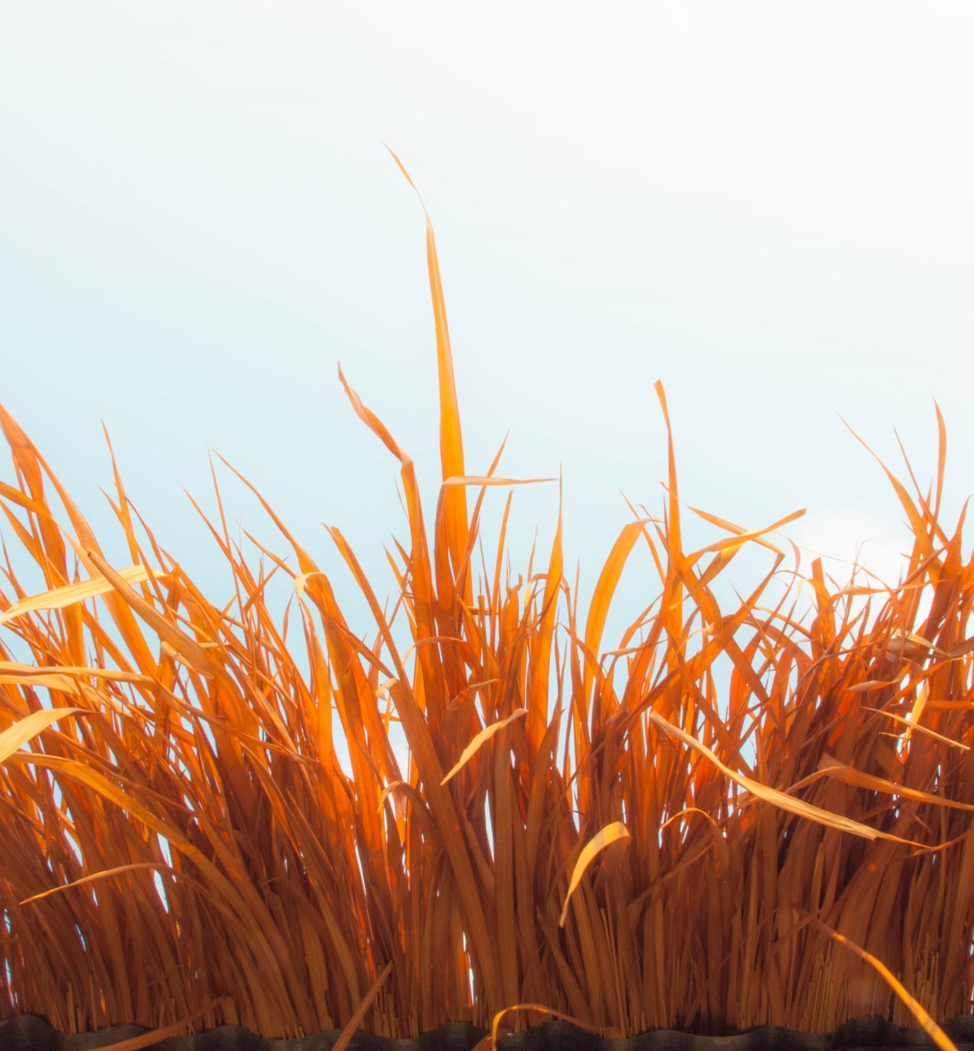

Grass Cutter System
To effectively clear tall grass and ensure a smooth path for the robot, a high-powered rotating fan mechanism is integrated into the design.
This fan mechanism efficiently cuts grass ahead of the robot, providing a clean and unobstructed route.

Slide 17


Camera Module
A camera module is also integrated in the front of the robot.
This camera module can provide quality real-time footage of the robot’s path for remote surveillance.
An array of high luminosity LEDs in front of the robot ensures clear vision even at nighttime.

Slide 18

Power Supply
Two Power banks (20Ah, 5V)
Batteries:
One 12V Battery
Two 9V Batteries

Slide 19
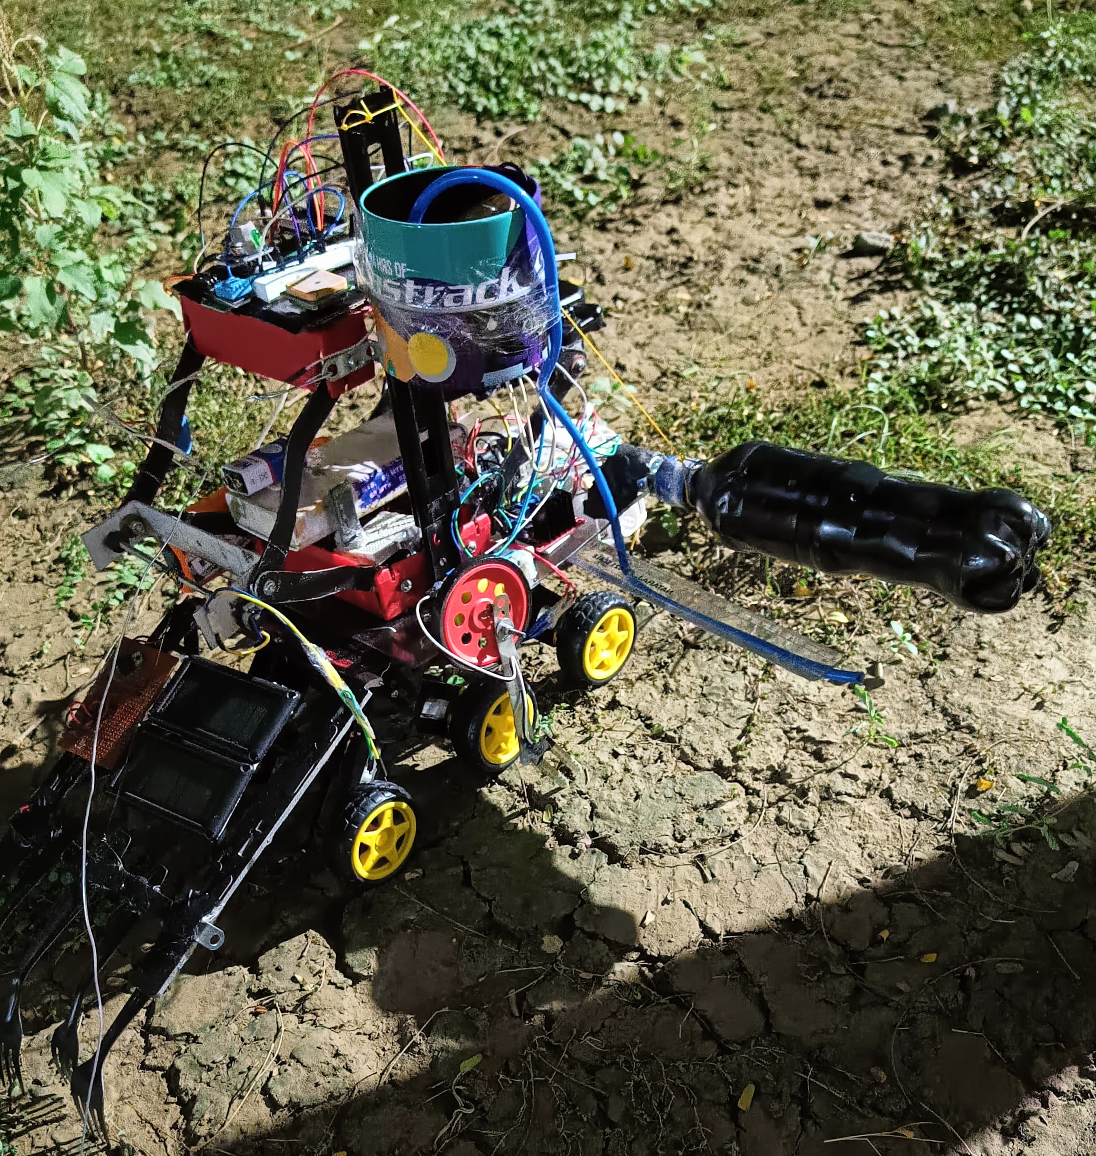
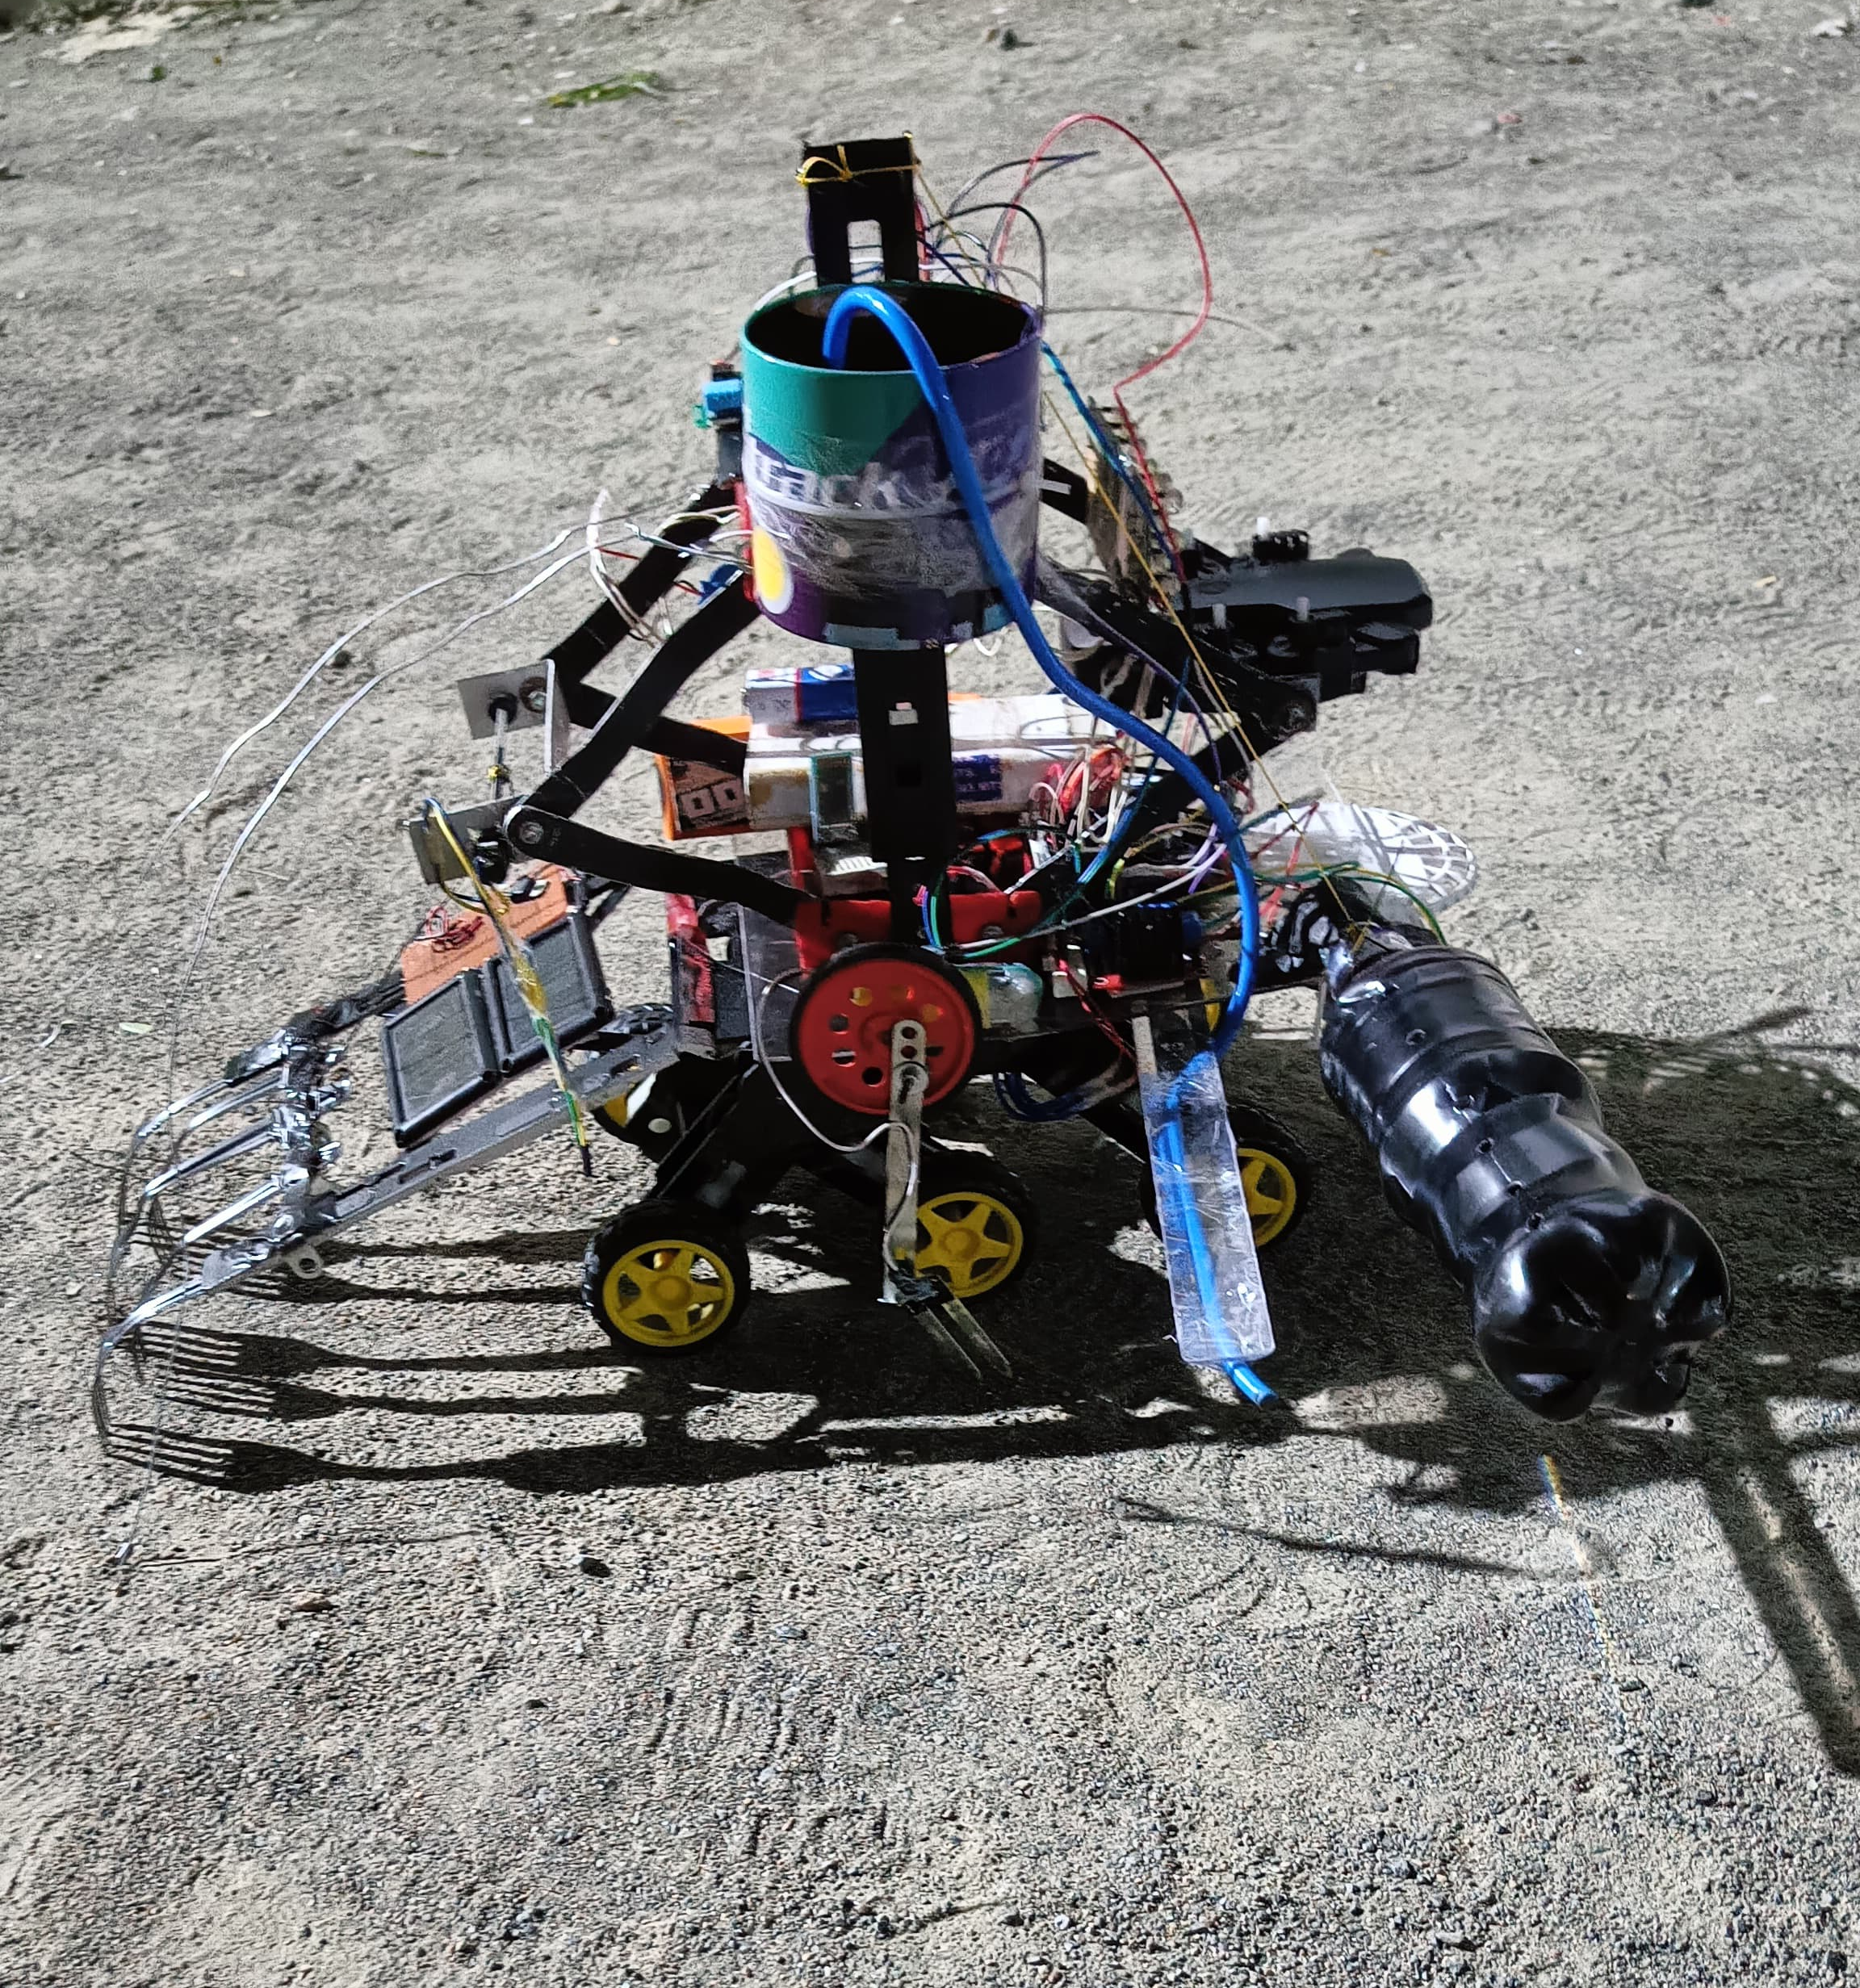
The Robot, at present…

Slide 20
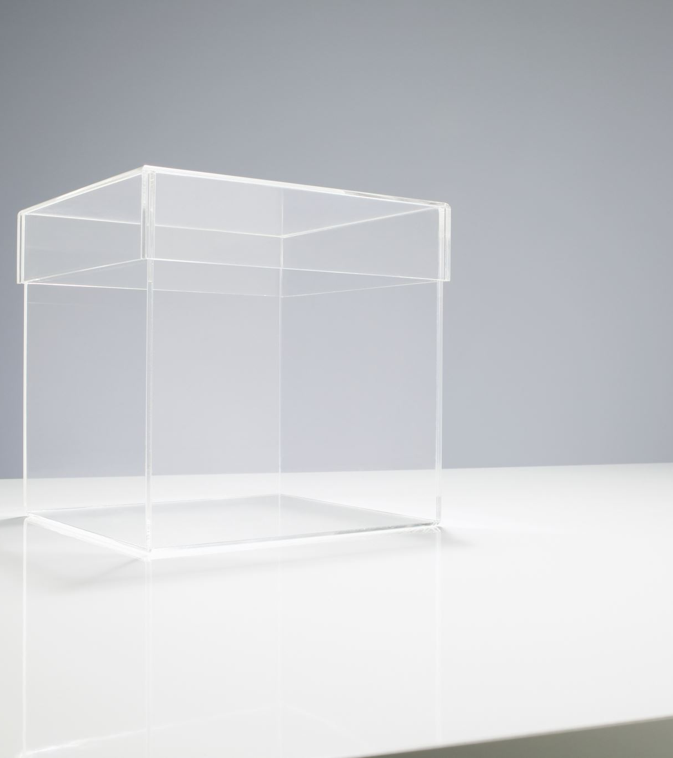
Video Showcase
Link to google drive with video showcase.

Slide 21
Thank You!

